Slide 1
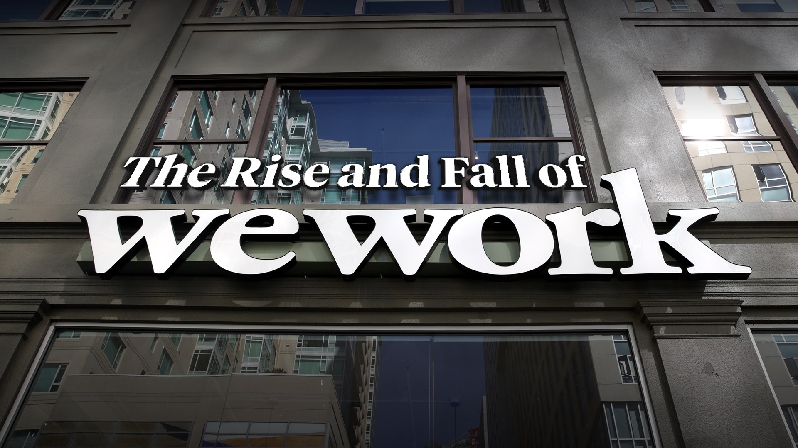
Avril Serrao
Ramesh Lakshman
Shrey Sheth
Vedant Patil

Slide 2
Introduction
WeWork is an American real estate rental company
Offers shared co-working space to independent contractors, startups, small and medium businesses, major or small gatherings, and emerging digital companies.
The company’s head office is situated in New York City, New York, USA. It also has many initiatives like; WeGrow, Rise by We, WeLive, WeWork, WeWork Labs.
Only after ten years did the company reach foothold in 37 nations, and by the end of 2019 it had 848 shared workplaces globally.
Adam Neumann - Former CEO (2019)
Sandeep Lakhmi Mathrani - Current CEO

Slide 3
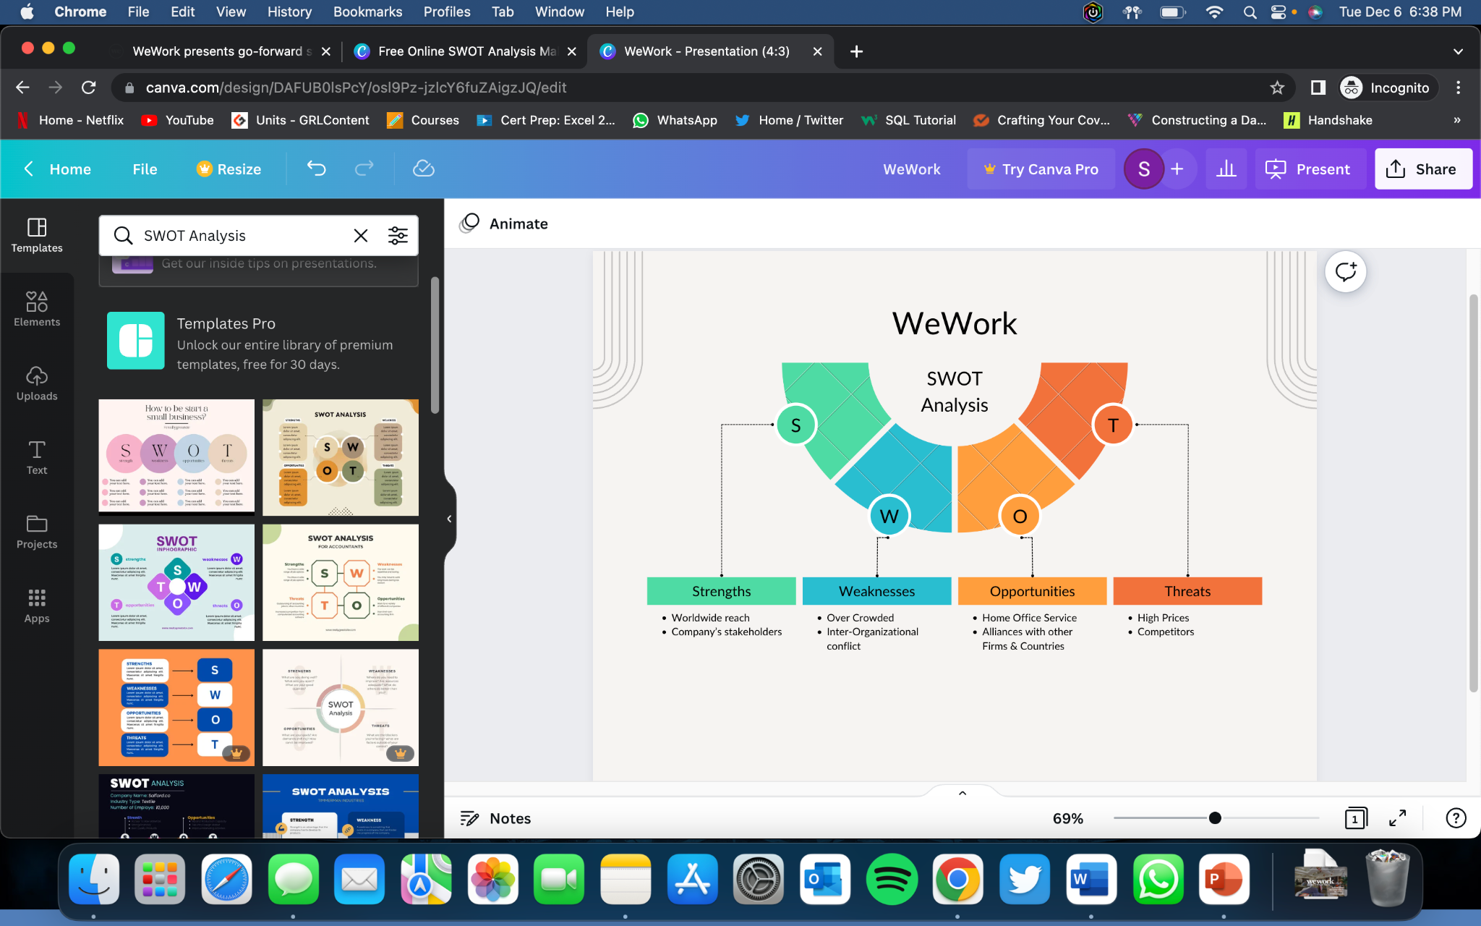
SWOT Analysis

Slide 4
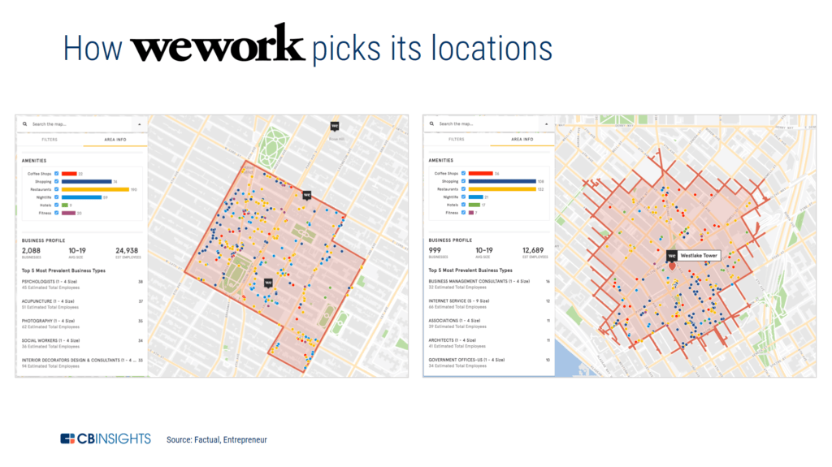
Products and Strategies
WeWork offers private desks, private offices, office suits, full floor offices, work on demand, all access, etc

Slide 5
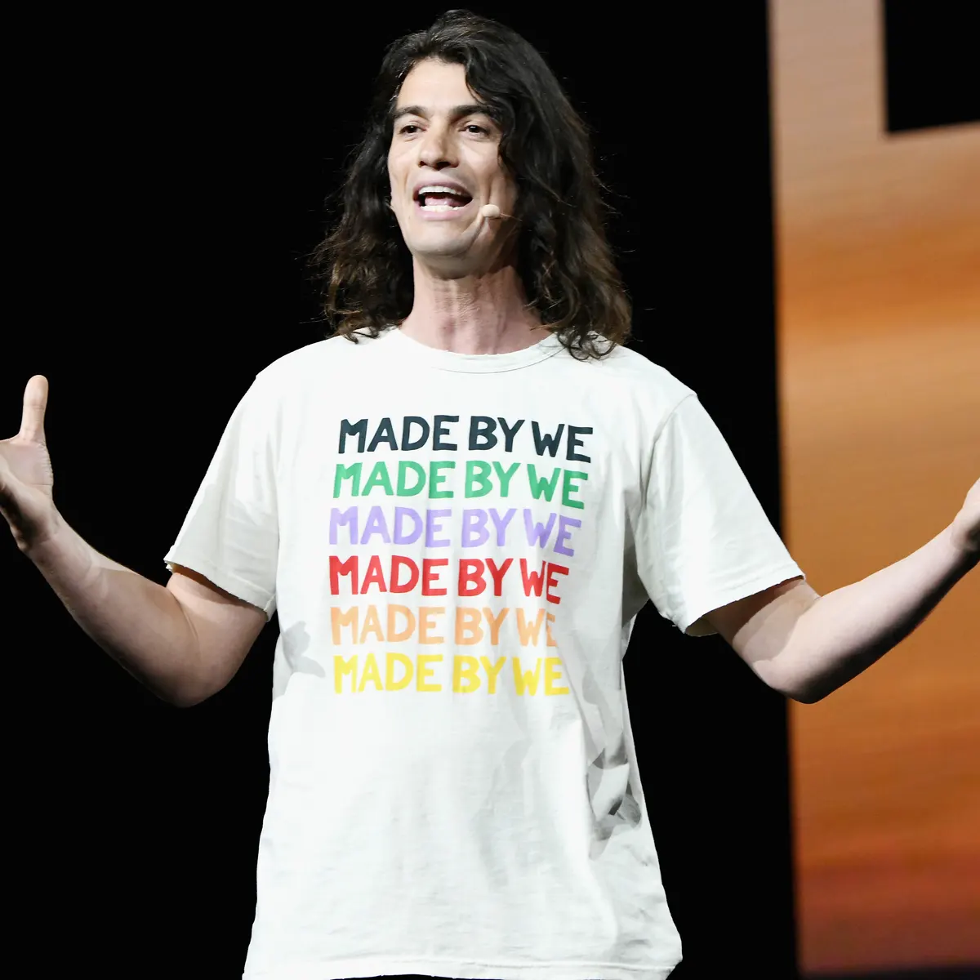
Human Resource Management
Ex CEO - Adam Neumann (2010-19)
Unconventional leadership style
Impulsive decisions
Conflict of interests
Charismatic individual - ambitious and idealistic
Employees
Summer camp - corporate retreat
14,000 employees in 2019 to 5,600 employees in 2020 (60% workforce cut)
Dec 2021 - 4,400 employees

Slide 6
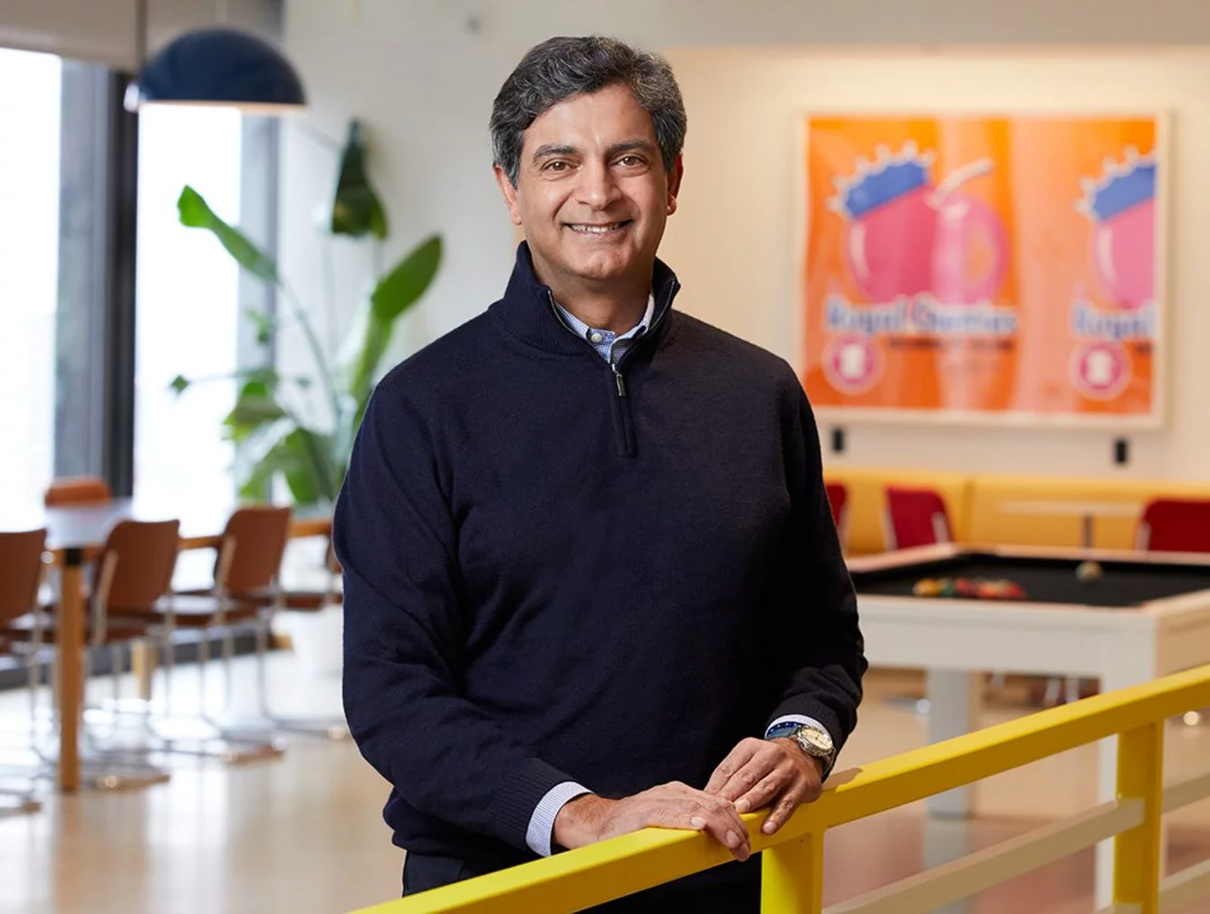
Human Resource Management
Management
2019 - Rebekah Neumann - Chief Brand Officer & Head of Private school
Current CEO - Sandeep Mathrani
Feb 2020 after the collapse of the IPO and exit of Adam Neumann
Indian American Origin
Real estate executive

Slide 7
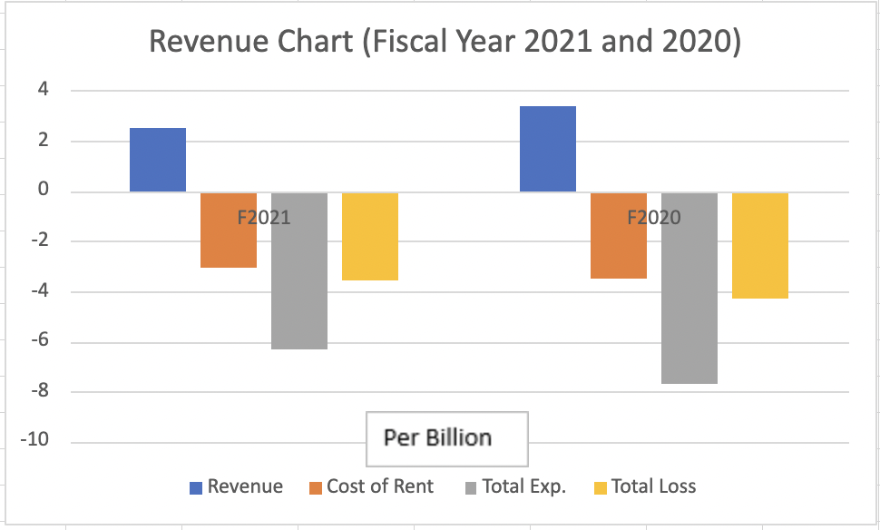
Financial Status

Slide 8
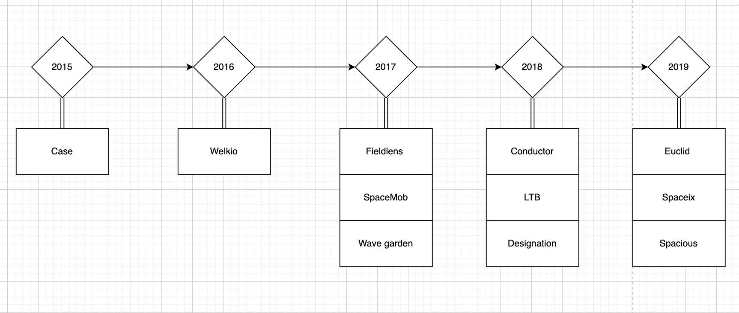
Acquisitions

Slide 9
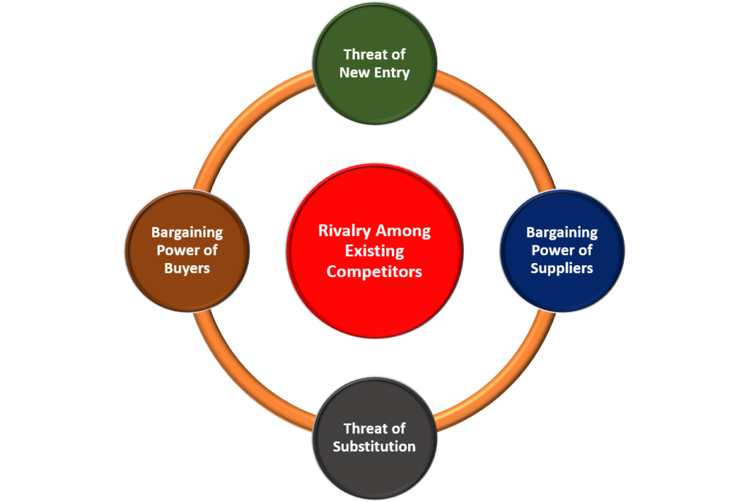
Planning
Create a work from home environment.
Create an environment that Neumann trusted in.

Slide 10
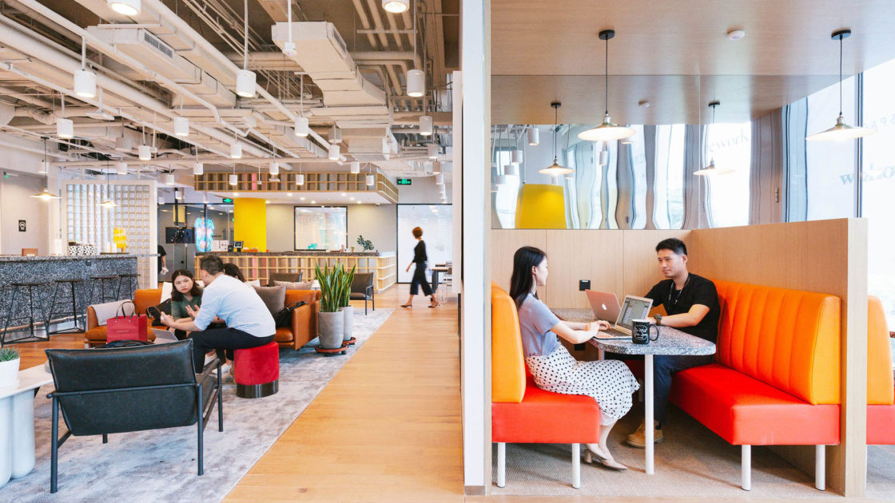
Global Management
Making an impact together
Caring for the global community
Putting people first
Improving the planet
Guided by principles
Social Responsibility
Banning meat i.e Animal welfare
Employment for the underprivileged, veterans and refugees
Partnering with local communities
Shift to Renewable energy resources

Slide 11
Innovation
What made WeWork successful?
The idea of WeWork was to be surrounded by a group of like-minded individuals, spend more time at work and just have fun doing it.
Although the idea of office subletting was not a new one, WeWork offered a new take on the idea. Their spaces were designed to be creative, collaborative, and aesthetically pleasing. Their rental terms were flexible with monthly terms available.
Limitations of WeWork
Unorthodox leadership: Neumann was impulsive and often made snap decisions.
Poor expansion plan: Neumann’s growth-first, profits later approach culminated in a USD 1.9 billion loss in 2018 and a loss of over USD 2 billion in 2019 which is roughly USD 5.5 million per day for the entire year.

Slide 12
Challenges, Advantages and Disadvantages
Challenges
Aggressive expansion, lower occupancy rate, charging basic rates for its deluxe properties, high lease costs, high operation or variable costs
Remote work
Non-Scalable business model
WeWork is focusing unilaterally on increasing its occupancy rate & users
Advantages
User Experience
Low Price with High Flexibility
Workspace With Great Location and Full Amenities
Connect To a Community That Helps Your Business Grow
Disadvantages
Privacy
Limited growth
Not ready for Prime time

Slide 13
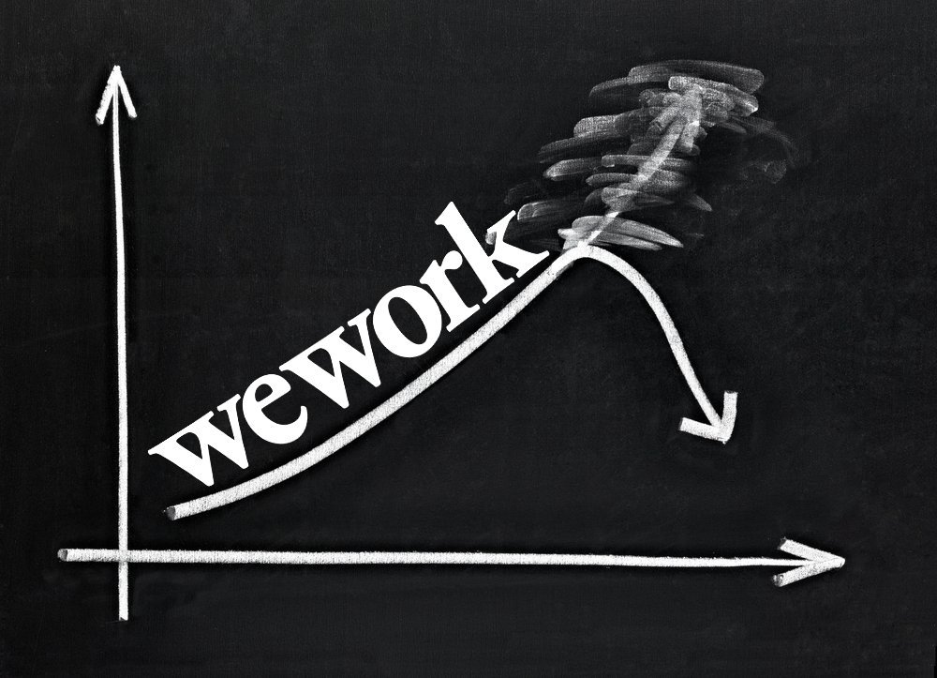
Downfall
Leadership and organizational culture
Neumann’s excesses and idiosyncrasies
Loss of trust after the IPO
Growth-first, Profits-later approach(Poor expansion planning)
Pandemic
Company’s expensive, unprofitable business model, as well as unethical and questionable behavior by CEO Neumann, are the main reasons for the brand’s failure

Slide 14
Future Projection
Short Term:
Earn the right to be the partner of choice : WeWork will demonstrate its value proposition to all of its partners across the entire ecosystem
Change in organizational culture
Deliver an amazing member and employee experience: WeWork should prioritize and invest in the member experience to deliver an even more collaborative, creative, and productive work environment.
Long Term:
Grow and expand geographically in a smart and profitable way
Operate with an ownership mentality
Execute the core business brilliantly, building by building: Current building economics in key locations coupled with a disciplined cost approach demonstrate the company’s ability to operate profitably over time.

Slide 15
Questions
Should it have been given a valuation closer to that of a real estate company, or was it appropriate to give it the tech company valuation(s) that it was given before the attempted IPO?
Are there ways to mitigate this risk while still adhering to the basic business model? If you were starting up a company like WeWork, how would you set things up?
How would you define a conflict of interest? What is it that makes a conflict of interest, such as Neumann’s, ethically suspect?
Growth first, Profits later? Would you describe this as an overreaction to the excesses of the We Company, or is it more of a recognition that profit should always be the primary focus? Would it have been better if Uber, for example, had been forced to focus on profitability before going public?
Hustle Culture? Is it accurate to identify the millennial generation as the source of these trends? What might be some other economic and societal factors that contributed to the excesses of the We Company?

Slide 16
Thank You!

